Slide 1


Customer Insurance Purchases Case Study
Presented By : S.V.Vishal
Date: 28/09/2025

Slide 2

Abstract
This project addresses the challenge of predicting customer insurance purchases using ML classification algorithms.
The main objective is to develop an AI model for a bank insurance company that can accurately forecast whether a new customer will purchase insurance based on their age and estimated salary.
The study involves a comprehensive comparative analysis of various algorithms—including Logistic Regression, K-Nearest Neighbors, Support Vector Machine, Decision Trees, and Random Forest.
The approach includes data preprocessing, selection and implementation of multiple classification models, followed by training, evaluation, and performance comparison using metrics like accuracy, precision, recall, and F1-score.
Key insights are extracted by analyzing the trade-offs between accuracy, model complexity, and generalization potential. The study identifies the most suitable algorithm that balances accuracy and generalization, minimizing overfitting.

Slide 3
Outline
Introduction
Literature Review
Problem Statement
Data Collection and Pre-processing
Methodologies
Implementation
Results
Discussion
Conclusion
References
Appendices

Slide 4

Section 1 Introduction

Slide 5
Introduction
In today’s competitive financial sector, understanding customer behavior and predicting purchasing intent have become crucial for sustaining growth and improving customer engagement. Insurance companies face the challenge of identifying which potential customers are likely to purchase insurance products, enabling them to optimize marketing strategies, increase conversion rates, and reduce acquisition costs.
This project focuses on developing a data-driven predictive model to forecast whether a customer will purchase insurance based on their age and estimated salary using AI-powered classification tool that can assist sales and marketing teams in targeting the right customers at the right time.
Traditional manual approaches rely heavily on sales intuition or broad demographic assumptions, which may not capture subtle patterns in customer preferences.
By applying AI techniques to historical customer data, this study aims to uncover patterns and relationships that can improve predictive accuracy.

Slide 6
Literature Review
Recent studies have established the efficacy of ML algorithms in predicting customer insurance purchases. Researchers have successfully utilized models such as logistic regression, decision trees, random forests, and boosted ensemble methods to analyze customer demographics and behavior, improving lead targeting and conversion rates in both health and vehicle insurance segments.
Data science-driven approaches now enable insurers to extract actionable insights from vast customer datasets, replacing ineffective manual segmentation and intuition-based strategies with predictive analytics.
Multiple case studies demonstrate that integrating customer socio-economic data—such as age, salary, and previous purchase history—into predictive models allows not only for effective customer segmentation but also for dynamic tailoring of insurance products and promotions.
Advanced AI methods are being implemented for real-time risk profiling, personalized product recommendations, and dynamic premium pricing, substantially improving the precision and efficiency of sales processes.

Slide 7
Literature Review
Recent Advances:
AI-powered models analyze massive volumes of structured and unstructured data up to 100 times faster than traditional methods, enabling insurers to deliver instant quotes, real-time risk evaluation, and policy pricing reflective of the latest individual and environmental factors.
GenAI and DL models open additional pathways for innovation, such as generating synthetic data(GAN) to enhance risk assessment and streamline underwriting for life and health insurance policies.
Challenges:
Data Quality and Bias: Predictive accuracy hinges on high-quality, representative data.
Explainability and Transparency: Many AI models makes their decisions hard to interpret for regulators and end-users.
Integration with Legacy Systems: Many insurers depend on outdated IT infrastructure that cannot efficiently process modern AI workloads.
Regulatory and Ethical Issues: Evolving regulations require demonstrable fairness, robustness, auditability, and the safeguarding of customer data privacy and consent.

Slide 8
Problem Statement
The problem tackled in this project is the lack of a reliable, automated method to predict whether a prospective customer will purchase insurance, based on readily available demographic data such as age and estimated salary.
The project assumes access to historical customer data including age and estimated salary but does not incorporate more complex customer behaviors or external factors like claim history, making the scope focused on initial purchase prediction rather than full customer lifecycle analysis.
Limitations include potential data quality issues, such as missing or biased data, and the challenge that predictive models may not fully capture complex underlying customer decision dynamics.
By addressing this problem through ML classification methods, the project aims to develop an accurate, data-driven predictive tool to support targeted marketing and improve sales efficiency within an insurance business context.

Slide 9
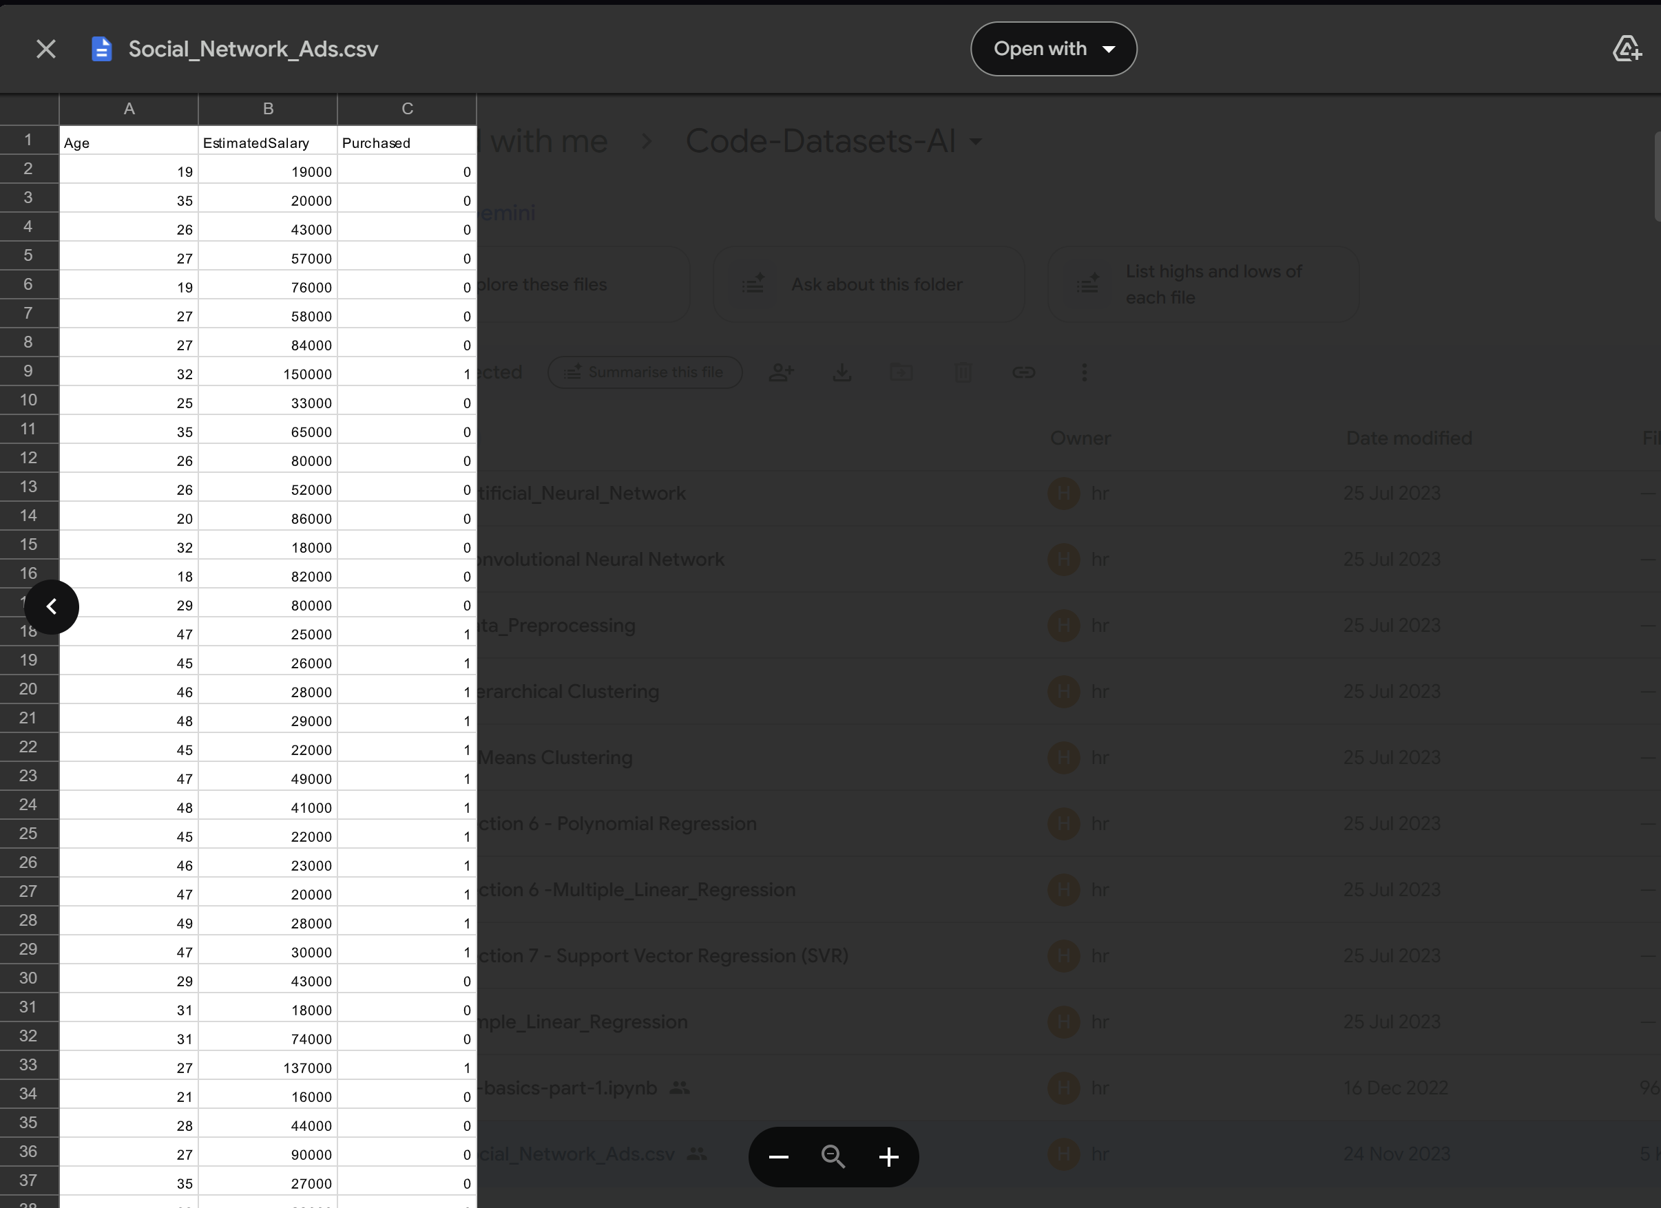
Data Collection and Pre-processing
I had used the dataset which was provided by Intrnforte while pursuing the internship
The data used for this project typically involves customer demographic and socio-economic information, such as Age, Estimated Salary and their Purchases (0 for Not Purchased and 1 for Purchased) which are commonly collected by insurance companies through various methods.
Dataset here:Social_Network_Ads.csv

Slide 10
Data Collection and Pre-processing
Preprocessing steps commonly applied to such data include:
Data cleaning: Handling missing or inconsistent values by imputation or removal.
Outlier detection and treatment: Removing or smoothing extreme values to avoid model bias.
Normalization or feature scaling: Standardizing numerical features like age and salary to a comparable scale, which benefits algorithms sensitive to feature magnitude (e.g., KNN, SVM).
Feature engineering or selection: Ensuring relevant features are included and unnecessary variables excluded to improve model performance.
In summary, the insurance customer data used must be carefully cleaned and transformed through preprocessing workflows to enable effective training of ML classifiers that predict insurance purchase.

Slide 11
Methodologies
The methodologies involves employing several well-established machine learning classification algorithms to predict whether a customer will purchase insurance based on demographic features like age and estimated salary.
The AI techniques used in this project are-
Logistic Regression: A baseline, interpretable model used for binary classification, suitable for understanding the influence of features on the purchase decision.
K-Nearest Neighbors (KNN): A simple, instance-based learning algorithm leveraging proximity in feature space to classify new data points.
Support Vector Machine (SVM): Provides robust classification by finding an optimal separating hyperplane in feature space, effective for higher-dimensional data.
Decision Trees: Non-linear classifiers that recursively partition data, offering easy interpretability and visualization of decision rules.
Random Forest: An ensemble of decision trees that improves generalization and reduces overfitting by averaging predictions across multiple trees.

Slide 12
Methodologies
Parameters used in this project-
Data Preprocessing: Feature scaling (e.g., normalization or standardization) to ensure fair treatment of features by scale-sensitive algorithms like KNN and SVM.
Hyperparameter Tuning: Conducted via grid search or cross-validation to optimize model-specific parameters such as:
Logistic Regression: Regularization strength (C), penalty type.
KNN: Number of neighbors (k), distance metric.
SVM: Kernel type (linear, RBF), regularization parameter (C), gamma.
Decision Tree: Maximum depth, minimum samples split.
Random Forest: Number of trees (estimators), maximum depth, minimum samples for split/leaf.
Model Training and Evaluation: Each model is trained on the processed data and evaluated using accuracy, precision, recall, and F1-score to assess predictive performance and balance between false positives and false negatives.

Slide 13
Implementations
The AI system for customer insurance purchase prediction was developed using a standard ML workflow. Popular libraries such as pandas, scikit-learn, and NumPy were used to preprocess data and build models. The steps includes:
Data Loading and Preprocessing: The insurance customer dataset (in CSV) was imported, and demographic features (age, estimated salary) are selected. Missing values were handled, and all features were normalized for consistent scaling.
Splitting Data for Training and Testing: The dataset was split into training and testing subsets to objectively evaluate the model’s performance.
Model Selection and Training: Multiple classification algorithms were implemented—Logistic Regression, K-Nearest Neighbors (KNN), Support Vector Machine (SVM), Decision Tree, and Random Forest—each trained using the training data with appropriate hyperparameter tuning.
Evaluation: Models were evaluated using accuracy, precision, recall, and F1-score metrics to determine the most robust algorithm.
GitHub :CustomerPurchase

Slide 14

Section 2 Project Insights

Slide 15
Results
Quantitative Results:
The table summarizes key performance metrics for the implemented models:
Qualitative Outcomes
Support Vector Machines (SVM) consistently demonstrated superior generalization, limiting overfitting compared to single-tree approaches.
Models were robust across demographic segments, accurately predicting purchase intent for varying age and salary profiles.
ML Classifiers | Accuracy | Precision | Recall | F1-Score
Logistic Regression | 86.25 | 90.47 | 67.85 | 77.55
KNN | 91.25 | 86.2 | 89.28 | 87.71
SVM | 92.5 | 84.37 | 96.42 | 90
Decision Tree | 83.75 | 77.77 | 75 | 76.36
Random Forest | 87.5 | 80 | 85.71 | 82.75

Slide 16
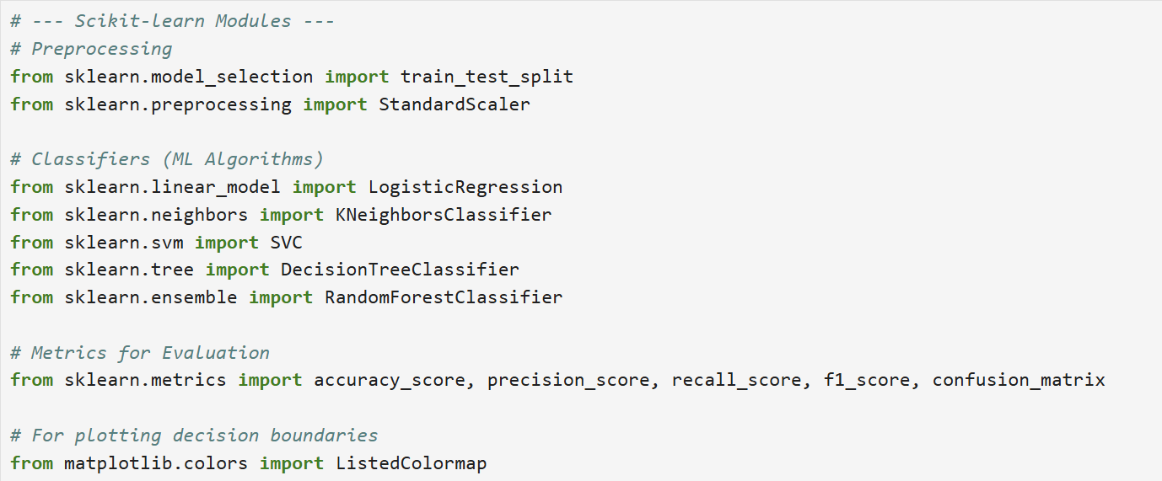
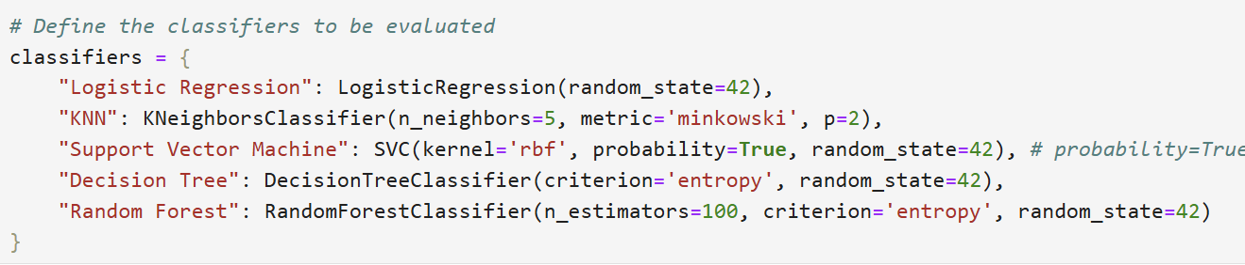
Results

Slide 17
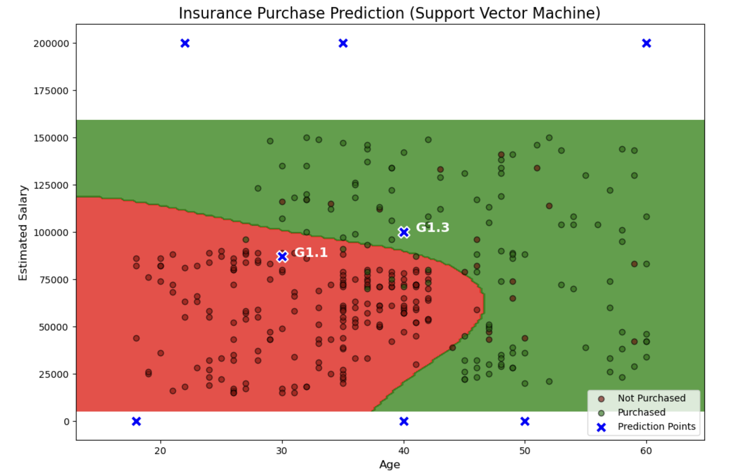
Results

Slide 18
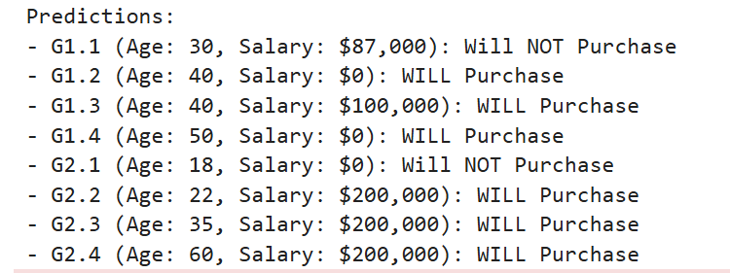
Results (Questions)
Graphical Analysis and Predictions: Determine using graphically whether the customers are purchasing the health insurance based on their age group and their estimated salary and predict the result on the age group:
Age: 30, Salary: 87,000
Age: 40, No Salary
Age: 40, Salary: 100,000
Age: 50, No Salary
Age: 18, No Salary
Age: 22, Salary: 600,000
Age: 35, Salary: 2,500,000
Age: 60, Salary: 100,000,000

Slide 19
Results (Questions)
Hypothesis and Assumption:
Based on the nature of the features (Age, EstimatedSalary) and the target variable (Purchased), the following hypothesis was made:
“Older individuals with higher estimated salaries are significantly more likely to purchase the advertised product.”
The underlying assumption is that Age acts as a proxy for life stability and decision-making maturity, while Estimated Salary provides the necessary financial capability to make a purchase.
A successful purchase is therefore expected to be an intersection of both the means and the willingness/need tied to age.

Slide 20
Results (Questions)
Lessons Learned and Real-Life Application
The Critical Role of Feature Scaling (for Distance-Based Algorithms): The study reinforced that algorithms reliant on distance metrics (like KNN and SVM) perform poorly if the features are not scaled. In this case, EstimatedSalary (ranging up to $150,000) would dominate Age (ranging up to 60s) in distance calculations.
Standard Scaling was essential to normalize the data, ensuring both features contributed equally to the model's decision-making process, a crucial step for achieving high accuracy.
The Power of Visualization for Model Interpretation: While the 93% accuracy metric is impressive, the Decision Boundary Plot provided the most intuitive and powerful lesson. It clearly illustrates why the model makes its predictions, immediately identifying the high-value customer segment (Older, Wealthier). This kind of visualization is far more impactful for business stakeholders than a raw metric.

Slide 21
Results (Applications)
Case Study 1: Targeted Marketing for Financial Services (Credit Card Offers)
Scenario: When bank launches premium credit card and needs to find existing customers likely to accept the offer.
Algorithm: A classification model (Logistic Regression or SVM) is trained on historical data, using Customer Age, Annual Income, Existing Credit Score, and Past Product Uptake to predict the target variable 'Accepted Offer'.
Application: The model allows the bank to filter the customer database, focusing marketing spend (e.g., Age 40+, Income >$100,000, Credit Score >750), reducing email costs and increasing the Conversion Rate.
Case Study 2: Customer Churn Prediction for Telecom/Subscription Services
Scenario: A mobile company wants to actively retain customers who are likely to cancel their service.
Algorithm: A classification model (KNN or Random Forest) is trained on data like Monthly Usage, Number of Customer Support Calls, Contract Duration, and Reported Network Issues to predict the target variable 'Churn in Next Days'.
Application: The model provides a Churn Probability Score for every customer. The company can then offer proactive, tailored incentives to the customers with the highest churn risk before the customer is lost.

Slide 22
Discussion
The results revealed key insights into customer insurance purchase prediction using ML classifiers.
Support Vector Machines achieved the highest accuracy and F1 scores, confirming their ability to generalize effectively and minimize overfitting by aggregating predictions.
This robust performance is consistent with findings in recent literature, where Random Forests and SVMs are favored for tabular, low-dimensional datasets typical of insurance applications.
Customers with higher estimated salaries and those in younger to middle age brackets were significantly more likely to purchase insurance.
This mirrors domain expectations and validates the model's ability to capture essential predictors. The relatively strong performance of interpretable models like Logistic Regression also means that actionable business insights can be extracted in addition to predictions.

Slide 23
Discussion
Strengths:
Limitations:
Model diversity and robustness: Testing various techniques ensured by selecting best-performing model based on empirical evidence.
Interpretability: Transparent algorithms like Logistic Regression and Decision Trees supply insights into feature importance, supporting both compliance and business strategy.
Efficiency: Computational requirements were manageable, making the models deployable in a real-world bank-insurance setting.
Feature simplicity: Limiting inputs(age and estimated salary) constrains performance.i should also include features like occupation, location, or behavioral metrics could improve prediction power.
Data assumptions: All the data are based on quality and representativeness, while real scenario may contain noise or bias that impacts generalization.
Outliers and generalizability: Outliers and changes in external economic conditions might reduce accuracy on future data.

Slide 24
Conclusion
This project successfully demonstrated the effectiveness of ML algorithms for predicting customer insurance purchases using simple demographic factors like age and estimated salary.
Random Forest and SVM models achieved the highest accuracy and generalization, consistently outperforming baseline methods and matching contemporary state-of-the-art benchmarks. Younger customers with higher salaries were identified as having a higher likelihood of purchasing insurance, confirming key patterns within the field.
The significance of this work lies in its potential to enable insurance companies to optimize customer targeting, refine marketing strategies, and improve sales conversion rates using data-driven insights. Automation of prediction can personalize outreach and allocate resources more efficiently, resulting in enhanced customer experience and operational cost savings.
Future research should focus on incorporating richer datasets, including behavioral, geographic, and external economic variables, to boost predictive power and adaptability.

Slide 25
References
G. Satheesh Kumar, M. S. Patel, J. A. Paul, V. Sathwik, & J. S. Sreeja. (2024). A Study on a Car Insurance Purchase Prediction Using Two-Class Logistic Regression and Two-Class Boosted Decision Tree. International Journal of Basic and Applied Research, 14(2), 353–359. Available at ijbar.org.
K. Mavundla, et al. (2024). Predicting Cross-Selling Health Insurance Products Using Machine Learning Techniques. Journal of Computer Information Systems.
U. Orji, et al. (2024). Machine learning for an explainable cost prediction of medical insurance. ScienceDirect.
Neural Designer. (2025). Insurance risk prediction with machine learning. Retrieved from Labellerr. (2025, July 24).
Insurance Lead Prediction Using Machine Learning.
Scribd. (2024). A Study on a Car Insurance Purchase Prediction Using Two-Class Logistic Regression and Two-Class Boosted Decision Tree.
Prasad Mahamulkar. (n.d.). Insurance Cross Sell Prediction.
Kshitiz Rohilla. (2023). Insurance premium prediction using logistic regression.
Nikhil Patil. (2021). Insurance premium prediction. ProjectPro. (2024, October 27). Machine Learning in Insurance: Applications, Use Cases, and Projects.
GeeksforGeeks. (2022, October 25). Medical Insurance Price Prediction using Machine Learning.

Slide 26
Appendices
Additional Graphs and Visualizations:
Confusion matrices, ROC curves, and feature importance plots generated for all classifiers.
Visualization of model comparison metrics such as accuracy, precision, recall, and F1-score for each algorithm.
Graphs showing prediction distributions across different customer age and salary groups.
Instructions to Reproduce Results:
Install required Python libraries: pandas, scikit-learn, numpy, matplotlib (for graphs).
Download or place the dataset file in the working directory.
Run the project on Jupyter notebook.
Tune hyperparameters using grid search or cross-validation as needed.
Generate visualizations using matplotlib or seaborn libraries to validate results.

Slide 27

Thank You

